Slide 1


SMART WATER VENDING MACHINE USING BLYNK IOT
CPS PROJECT
P.NARUN RAM P.SAI DEVA HARSHA S.P PRIYEN
(CB.EN.U4EEE22029) (CB.EN.U4EEE22031) (CB.EN.U4EEE22039)
M.UTTAM –(CB.EN.U4EEE22050)

Slide 2
INTRODUCTION
A Smart Water Vending Machine automates the dispensing of bottle using IoT technology.
Controlled via an ESP8266 microcontroller with Blynk for remote selection and payment.
Enhances convenience and reduces manual intervention.

Slide 3
PROBLEM STATEMENT AND SOLUTION
Problem: Solve a typical problem 0f Automatic Water vending machine.
Solution: We Developed a smart and automated vending machine using ESP8266 and mobile payments.

Slide 4
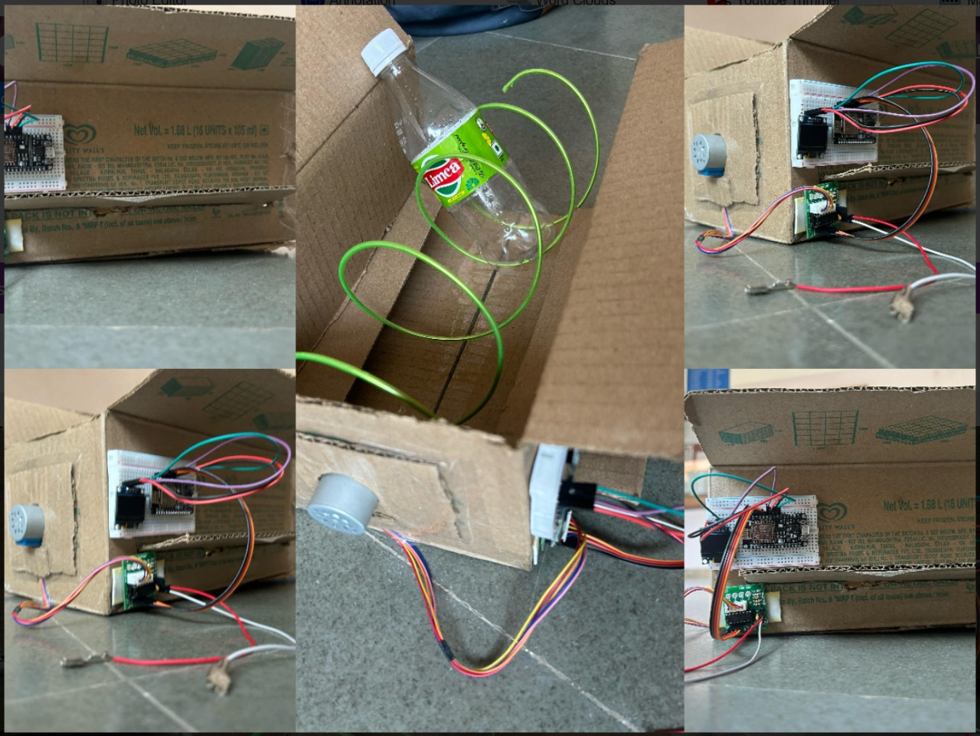
PROJECT DESIGN AND ARCHITECTURE

Slide 5
PROGRAMMING SOLUTION
Blynk Integration:The code uses Blynk virtual pins (V1 for bottle selection and V3 for payment) to receive user input, update the display, and trigger water dispensing.OLED Display Feedback:An OLED screen provides real-time feedback, displaying machine status, user selections, pricing details, and dispensing messages.Stepper Motor Control:The motor, driven through a defined 8-step sequence, rotates a set number of steps (4 full rotations per bottle) to dispense water based on the selected number of bottles.System Flow:The machine initializes WiFi and display, waits for a bottle selection, updates the display with the selected number and corresponding price, and then waits for a payment command. Once payment is received, the motor rotates the required steps to dispense water, and the display shows a thank-you message before resetting

Slide 6
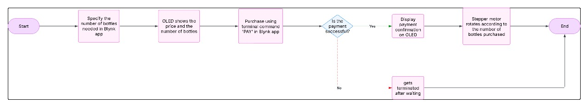
FLOW EXPLANANTION

Slide 7
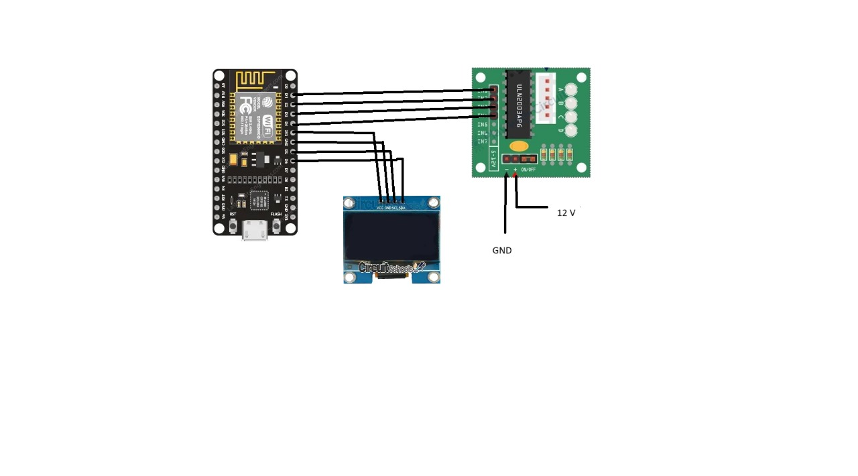
WIRING DIAGRAM
Shows a circuit diagram connecting:
ESP8266 to OLED Display for feedback.
ESP8266 to Stepper Motor Driver for bottle dispensing.
Power supply connections.
.

Slide 8
COMPONENTS WORKING PRINCIPLE AND FUNCTIONALITY
Stepper Motor (SBT0811): Moves the bottle dispensing mechanism step by step
ESP8266: Main controller, handles user input, processing, and motor control.
OLED Display: Provides real-time feedback.
Blynk App: Acts as a user interface for selecting bottles and making payments

Slide 9
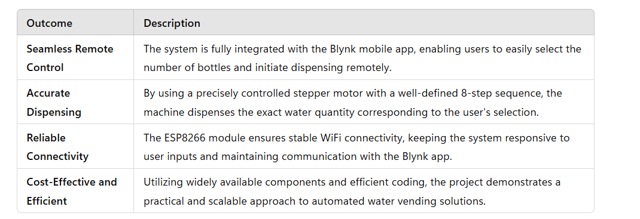
Project outcome

